Slide 1
Muddi Backend
Make an example postgres schema to demonstrate the minimum requirements for muddi compliance
Transform sample data into a muddi compliant format

Slide 2
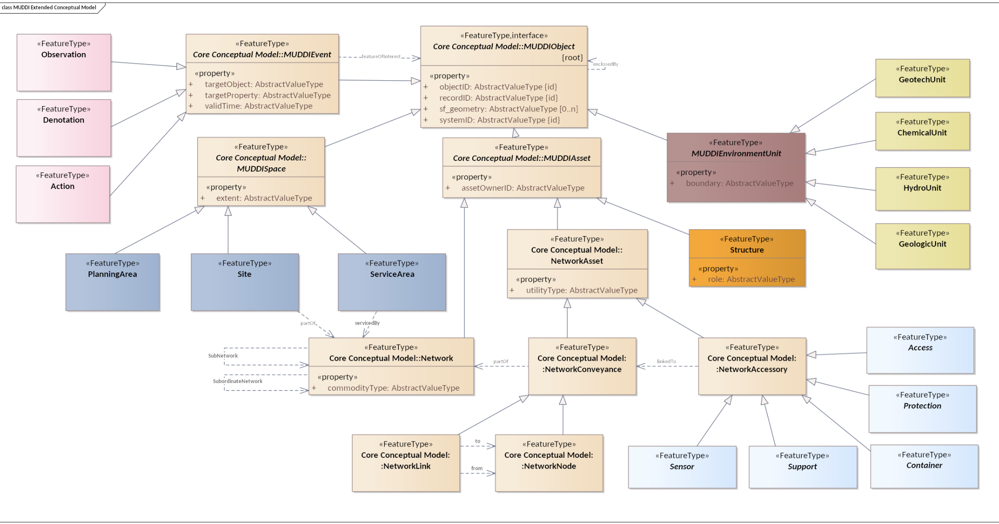

Slide 3
c

Slide 4
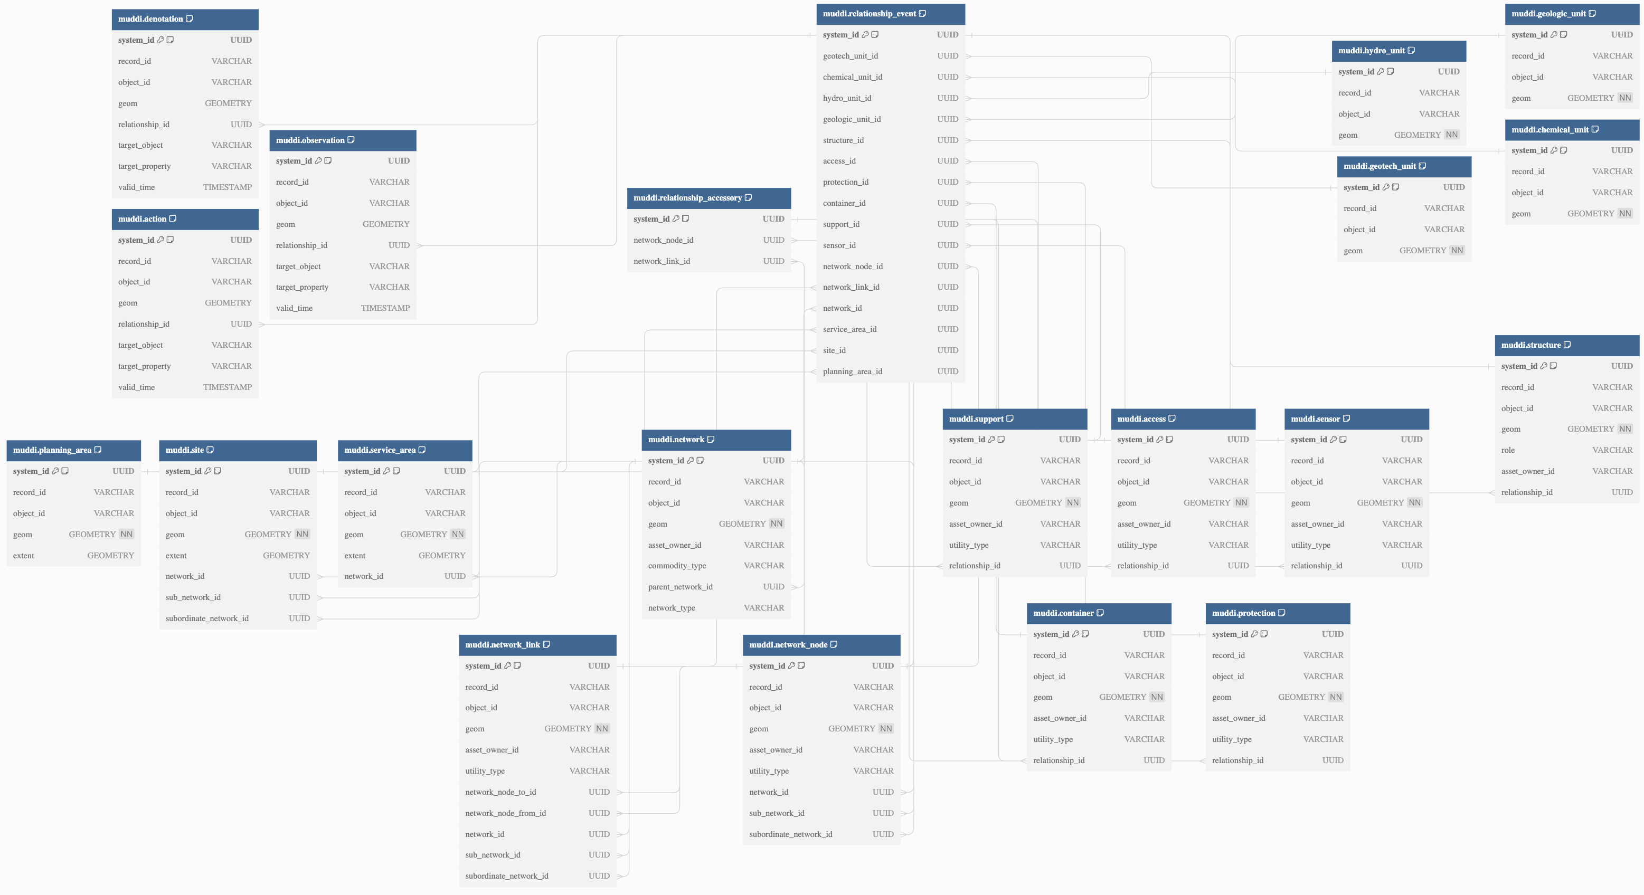
https://dbdocs.io/richard.hargreaves/MUDDI-Logical-Schema

Slide 5
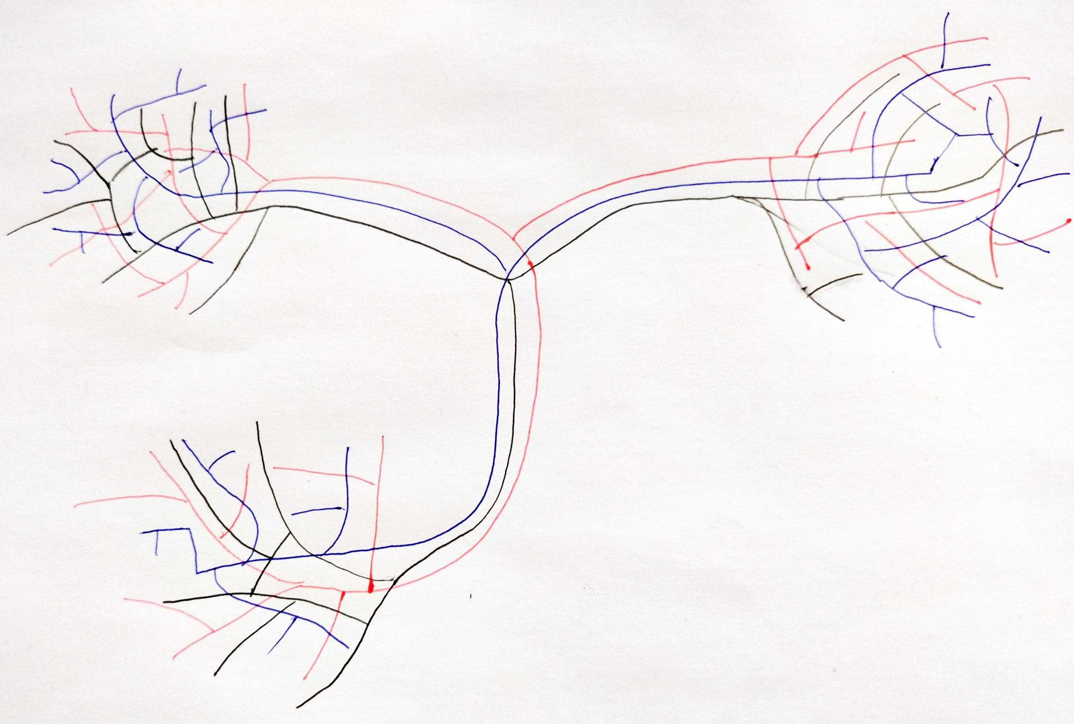
Network

Slide 6
Network
Subnetwork
= subset of a network based on geographic extent

Slide 7
Network
LP
MP
HP
Subordinate
network
= subset of a network based on an asset property
Subnetwork
= subset of a network based on geographic extent

Slide 8
Next Steps
The logical schema is intended to to act as a template for muddi compliance
It is expected that in any implementation with real data additional attribution would be added and tables extended
In our implementation we ingested NGN (gas) and UKPN (electricity) open datasets

Slide 9
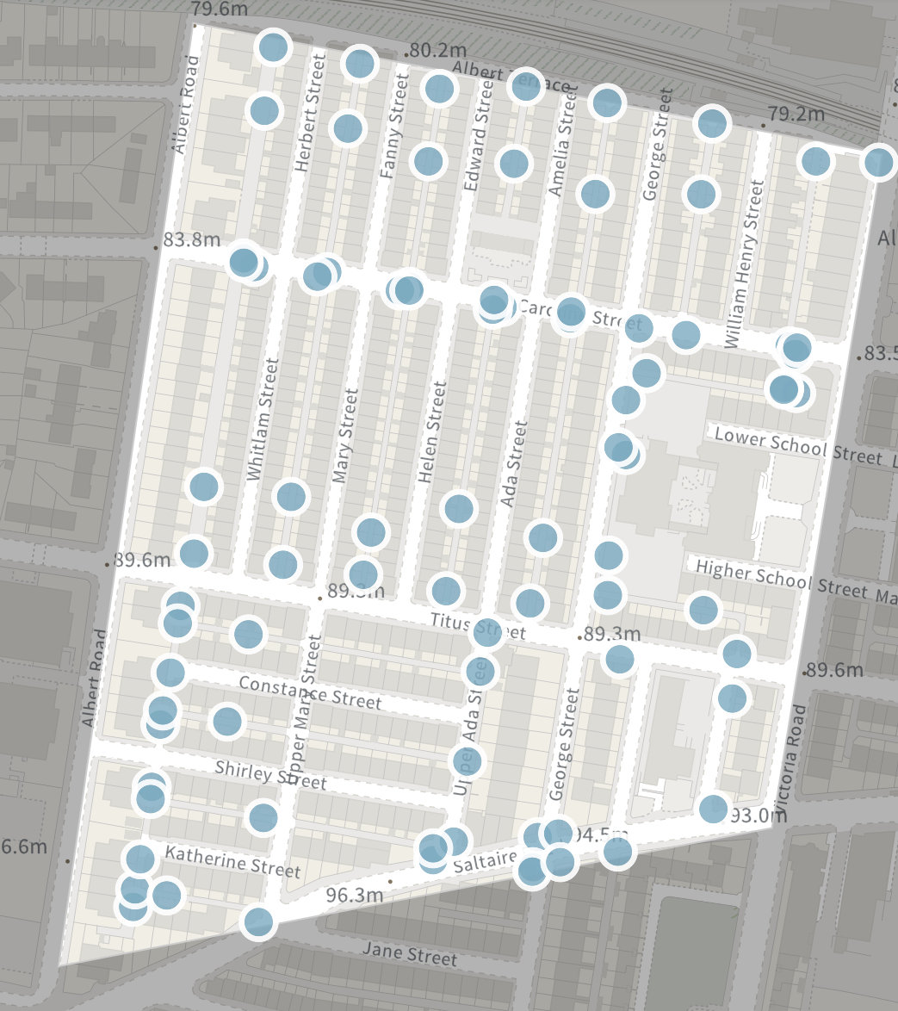
Front-end
Enhancing a demonstrator project to display 'MUDDI' data
Completes a sample end-to-end process:
Ingesting two independently-created non-standard data sources
Storing into MUDDI-compliant database
Displaying data via database view layers and a pygeoapi API
Lots of potential:
What features of a display tool could be tailored to MUDDI data?

Slide 10
